Slide 1
Chapter 9 Memory、CPLD and FPGA
本章要求:
存储器中的ROM及其用于组合逻辑电路的设计；
ROM, RAM的地址和存储容量的关系，以及容量的扩展等基本知识。

Slide 2
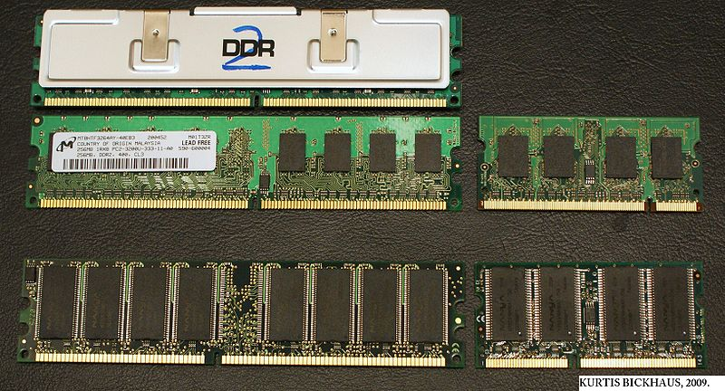
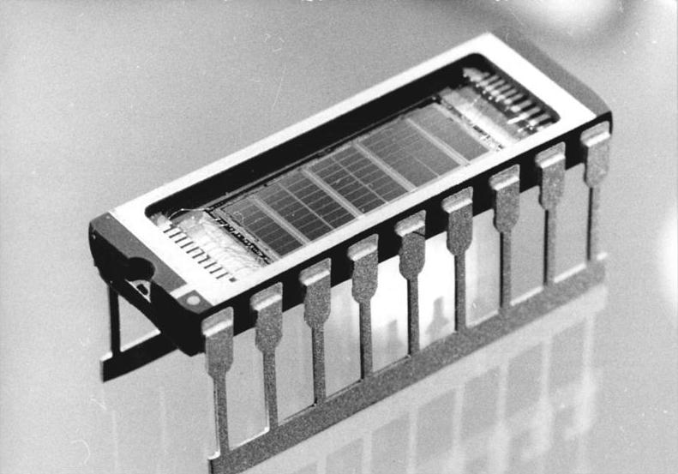
memory
memory：store bits in a structured way
ROM
(read-only memory)
RAM
(random-access memory)
Non-volatile while powered down
Volatile while powered down
Often be used store firmware or initial program of the computer…
Data exchange and storing temporarily in CPU or other microprocessor

Slide 3
9.1 Read-Only Memory (ROM)
1. basic structure
sketch map of RAM
2^{n} words × b bit ROM
n-bit address
D_{b-1}
…
D₀
A0
D0
0…00
0100….1011
A1
b-bit data (output)
n-bit address (input)
D1
0…01
×××××
A2
…
2^{n}
words
…
A_{n-2}
D_{b-1}
A_{n-1}
1…11
×××××
the data input and output in parallel.
b-bit data

Slide 4
2. Internal ROM structure
A0
Row (address) decoder
0
storage array （2^{n}×b）
A1
1
address input
…
…
2^{n}-1
A_{n-1}
…
output circuit
…
D_{b-1}
D0
Data output

Slide 5
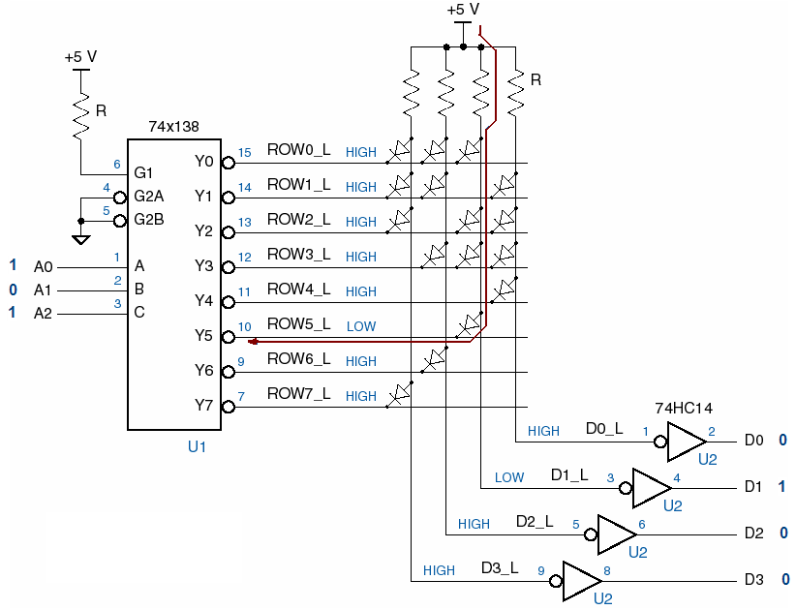
8×4 ROM structure
has diode: store 1
no diode: store 0
address decoder
a data stored unit
data stored array
address input
输出电路
word line
Data output
bit line

Slide 6
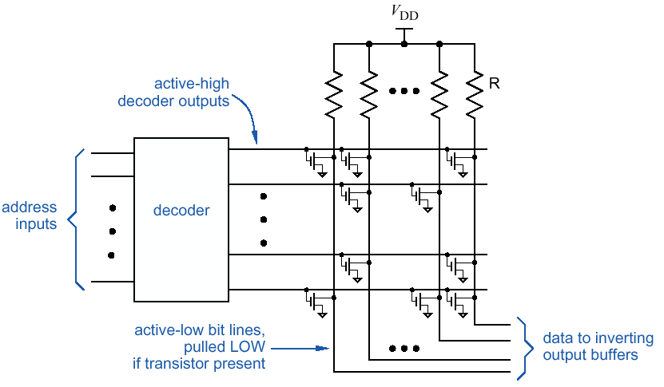
MOS transistors as storage elements
A transistor means a ‘1’
Nothing means a ‘0’
When address bits are increased, the chip’s physical dimensions are closed to a narrow rectangle.

Slide 7
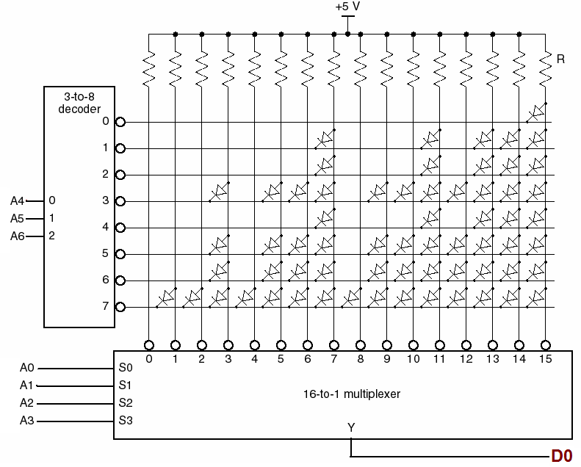
3. Two-dimensional decoding
128 words×1 bit ROM
地址位数较多, 采用二维译码方式
0000000~0001111
0010000~0011111
……
1110000~1111111

Slide 8
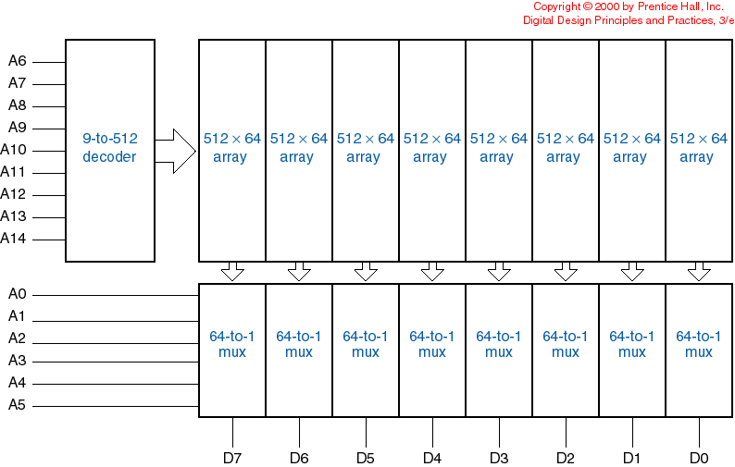
Example: a 32Kx8 ROM
two-dimensional address decode
2¹⁵ word×1 bit

Slide 9
4. commercial ROM types
mask-programmable ROM
array connections are programmed during semiconductor manufacture using a mask. very fast. very dense. expensive, 2-4 week turn-around, low power
Programmable ROM(PROM)
fuses to program once in the field, use PROM programmer, inexpensive
word line
fuse
bit line

Slide 10
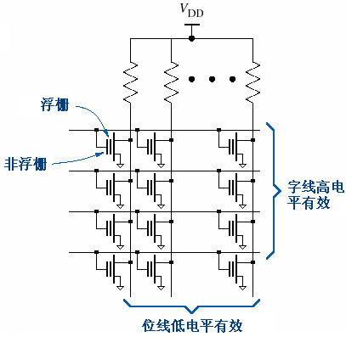
EPROM（Erasable PROM）
fuses implemented using floating-gate MOS transistors to program 10k~100k times in the field, erased by flooding with UV light.

Slide 11
E²PROM（Electrically EPROM）
byte-program, individual stored bits may be erased electrically.
2764(8k×8), 27128(16k×8), 27256(32k×8), 27512(64k×8)
flash EPROM
a specific type of EPROM which can be erased in large blocks
NOR type and NAND type
NOR flash allows a single machine word (byte) to be written or read independently
NAND flash is programmed and read in pages, and erased in blocks.
USB device
solid-state drives (SSDs)

Slide 12
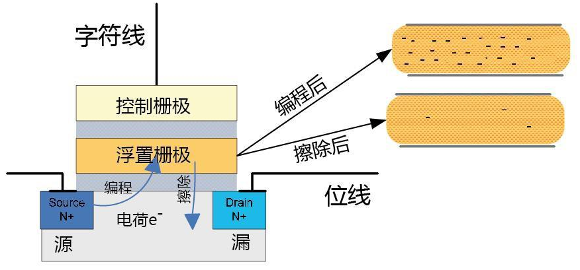
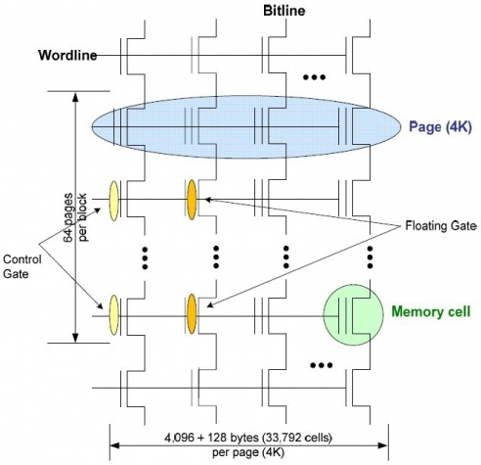
Exp. NAND flash ROM’s structure
Bit-storage unit
A block of an NAND flash ROM

Slide 13
Array organization of a 2GB NAND flash ROM
（Main Area）
（Spare Area）

Slide 14
Others about EEPROM
按照数据的输入/输出分为串行EEPROM和并行EEPROM。
串行EEPROM：在读写数据时，输入/输出时通过2线、3线、4线或SPI总线等接口方式进行的。
并行EEPROM：数据的输入/输出是通过并行总线进行的。
近期，低功耗，写入/擦除速度快的产品很多，如Microchip公司的新型8千位、16千位串行EEPROM，最快时钟10MHZ，写入时间5ms，电流3mA,内置写保护功能，可保存数据达200年，承受100万次擦写。Atmel公司的AT24C××系列……

Slide 15
5. Using ROM for “random” combinational logic functions
Store the output value of a given truth table in the ROM, the function inputs are connected to the address input .
Exp1: the dual polarity decoder.(P.801)
POL | I1 | I0 | Y3 | Y2 | Y1 | Y0
0 | 0 | 0 | 0 | 1 | 1 | 1
0 | 0 | 1 | 1 | 0 | 1 | 1
0 | 1 | 0 | 1 | 1 | 0 | 1
0 | 1 | 1 | 1 | 1 | 1 | 0
1 | 0 | 0 | 1 | 0 | 0 | 0
1 | 0 | 1 | 0 | 1 | 0 | 0
1 | 1 | 0 | 0 | 0 | 1 | 0
1 | 1 | 1 | 0 | 0 | 0 | 1
8×4 ROM
I0
A0
D0
Y0
I1
A1
D1
Y1
POL
A2
D2
Y2
D3
Y3

Slide 16
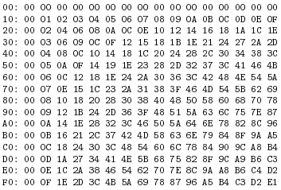
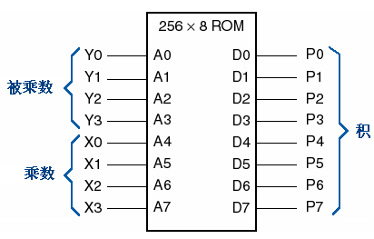
Exp2: 4×4 multiplier
每行第一个数据单元的地址
每行包含16个数据单元的数据

Slide 17
More Exp.: ROM在同步时序电路设计中的应用
位序列信号的产生：计数器 — ROM法
设计一个码长为8位的序列信号发生器，信号序列为01111110。
V_{CC}
74××163
8×4ROM
CLK
CLK
CLR
LD
QD
D0
SEQ
ENP
QC
ADD0
ENT
D1
QB
ADD1
D
QA
ADD2
D2
C
D3
B
RCO
…
A

Slide 18
Function table for the sequence generator with ROM
address QC QB QA | Data stored in ROM D3~D0
000 | 0000
001 | 0001
010 | 0001
011 | 0001
100 | 0001
101 | 0001
110 | 0001
111 | 0000
For n-bit ROM, it can implement n outputs logic function.

Slide 19
ROM在组合电路设计中的应用举例
Try to use 8×4ROM to realize the following function:
F1=AB+A’C, F2=AB+B’C
Solution:
transform the equation to canonical form first
put the input variable on the address line of ROM,
Store the F1, F2
用16字×4位ROM实现2输入变量的与非、或非、异或和同或
实现4位二进制码—格雷码的转换

Slide 20
Random-access memory (RAM)
Random access means:
locations in the memory can be written to or read from in any order, regardless of the memory location that was last accessed.
Static RAM
Dynamic RAM
store a bit of data in the state of a flip-flop
store a bit of data as a charge in a capacitor
both are volatile

Slide 21
9.3 Static Random-Access Memory
2^{n} word ×b bit RAM structure
CS、WE有效，b位数据输入
A0
Address inputs
A1
D_{b-1}
D0
…
An-1…A0
D0
…
A_{n-2}
D1
Data outputs
0…00
×××××
A_{n-1}
0…01
×××××
Din0
Data inputs
…
D_{b-1}
…
…
Din_{b-1}
CS
1…11
×××××
Control inputs
OE
WE
CS、OE有效，b位数据输出

Slide 22
SRAM internal structure
…
A0
Address decoder
0
D_{b-1}
D₀
Storage array (M×b)
A1
1
…
…
M-1
A_{n-1}
…
WE_L
WR/RD
control
Output circuit
CS_L
OE_L
…
D_{b-1}
D₀

Slide 23
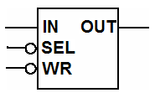
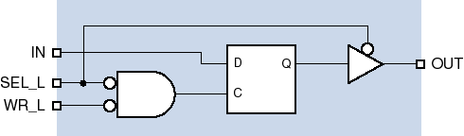
A static-RAM cell
SEL_L、WR_L both negated, D latch hold the data；
SEL_L is asserted, WR_L is negated,tri-state buffer enable, data output (read);
SEL_L、WR_L both be asserted, D latch open, a new bit is stored (write).

Slide 24
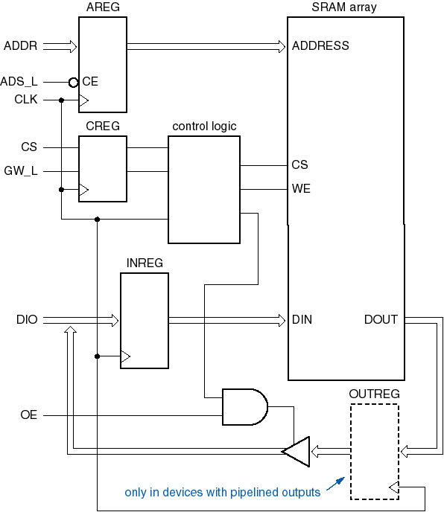
synchronous SRAM
A bit of storage is also a latch.
Put registers in front of address and control (and maybe data) interface, and operation is performed during a clock period.

Slide 25
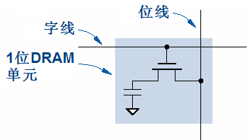
9.4 dynamic RAM
store a bit of data in a separate capacitor through a MOS transistor, and need to be refreshed periodically.
Read:
- Precharge bit line to VDD/2.
- Take the word line HIGH.
- Detect whether current flows into or out of the cell.
- Note: cell contents are destroyed by the read!
- Must write the bit value back after reading.
Write:
Charge the capacitor--- store 1;
Discharge the capacitor---store 0.

Slide 26
SDRAM
Control and data operations are referenced to a common clock signal.
是single data rate, 与系统总线速度同步，在一个时钟周期的上升沿传输一次数据。
曾经是PC电脑上最为广泛应用的一种内存类型 ，分为PC66、PC100、PC133等不同规格，而规格后面的数字就代表着该内存最大所能正常工作系统总线速度

Slide 27
双数据传输模式同步动态随机存储器，即DDR SDRAM (Double Data Rate Synchronous Dynamic Random Access Memory)
是一种继SDRAM后产生的内存技术，为具有双倍数据传输率之SDRAM，其数据传输速度为系统频率之两倍，由于速度增加，其传输效能优于传统的SDRAM。
一个时钟周期内传输两次次数据，它能够在时钟的上升期和下降期各传输一次数据 。

Slide 28
Memory expanding
1. bit expanding
例：从1024×4bit扩展为1024×8bit
解：将4比特的芯片增加一片，地址线接至两片芯片的相同的地址端。
CS
R
/
W
A
0
A
9
A
9
L
A
0
R/W
CS
A
9
L
A
0
R/W
CS
2114（I）
2114（Ⅱ）
D₃
D₂
D₁
D₀
D₃
D₂
D₁
D₀
2114芯片位扩展
D₇
D₆
D₅
D₄
D₃
D₂
D₁
D₀
数据输出

Slide 29
2.word expanding
例：从1024×4bit扩展为4096×4bit
A₁₁ A₁₀=11
A₁₁
2-4
译
码
器
A₁₁ A₁₀=10
A₁₁ A₁₀=01
A₁₀
A₉… A₀
A₁₁ A₁₀=00
R/W
A
9
L
A
0
R/W
CS
A
9
L
A
0
R/W
CS
A
9
L
A
0
R/W
CS
A
9
L
A
0
R/W
CS
2114（1）
2114（2）
2114（3）
2114（4）
D₃
D₂
D₁
D₀
D₃
D₂
D₁
D₀
D₃
D₂
D₁
D₀
D₃
D₂
D₁
D₀
2114芯片字扩展
D₃… D₀

Slide 30
3. word-bit expanding
Exp. Use HM6264 SRAM(8k×8) to construct a 32k×16 memory.
Solution:
Need two chips to construct a 8k×16 memory block
And need 4 groups 8k×16 block
assign the address A14~A0 and data output D15~D0

Slide 31
A₁₂A₀=11
A₁₄
2-4
译
码
器
A₁₂A₀=10
A₁₂A₀=01
A₁₃
A₁₂A₀=00
CS
A₁₂..A₀
…
…
…
A12…A0
CS1
CS2
A12…A0
CS1
CS2
A12…A0
CS1
CS2
WE
WE
WE
OE
6264(1)
OE
6264(3)
…
OE
6264(7)
IO7…IO0
IO7…IO0
IO7…IO0
…
D7
D0
…
…
D7
D0
D7
D0
WE
OE
…
…
…
A12…A0
CS1
CS2
A12…A0
CS1
CS2
A12…A0
CS1
CS2
WE
WE
WE
OE
6264(1)
OE
6264(3)
…
OE
6264(7)
IO7…IO0
IO7…IO0
IO7…IO0
D15
…
D8
D15
…
D8
D15
…
D8

